Slide 1
Modelling of Vienna Rectifier using Hysteresis current control loop

Slide 2
Team members:
Anjan Kumar. V (212712105013).
Arjun. E (212712105019).
Dheenu. K (212712105029).
Jones. A (212712105042).
Project Guide
Tamizhselvan A (AP, EE)
Place of the Project: SVCE

Slide 3
Objective:
The main objective of this project is to model Vienna Rectifier with suitable hysteresis current controller to
1. Get unity power factor
2. Reduce total harmonic distortion
3. Regulate the output voltage

Slide 4
Abstract:
The Vienna Rectifier is a unidirectional three-phase three-switch three-level Pulse-width modulation (PWM) rectifier. It can be seen as a three-phase diode bridge with an integrated boost converter. Hysteresis current control loop is a control loop which is used to control the output current, so as to obtain the optimal value. It also plays an important role in reducing the voltage and current THD in the system. The application of this device are multifold.

Slide 5
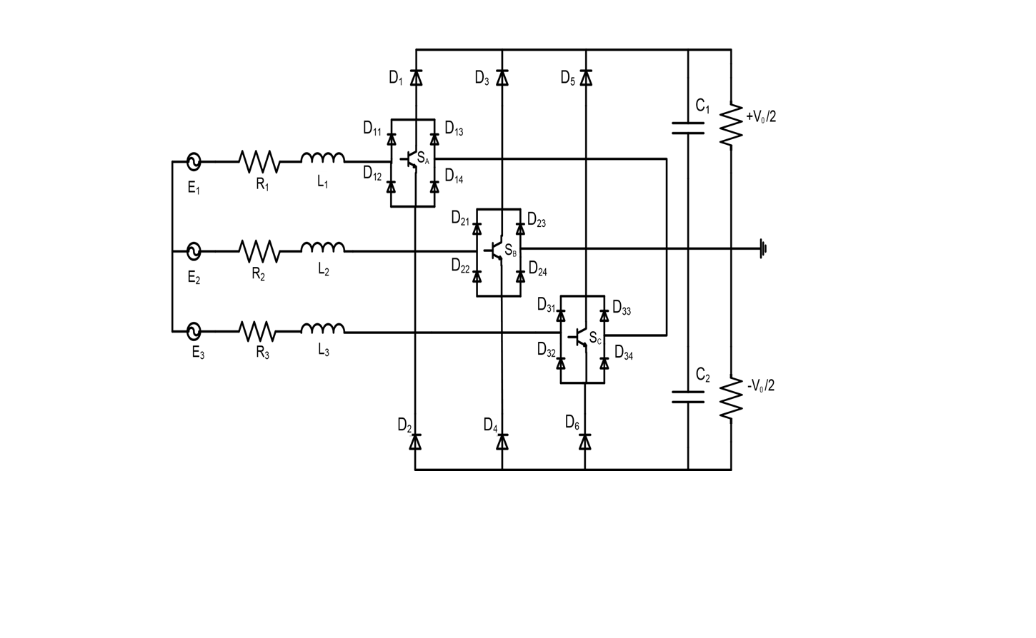
CIRCUIT DIAGRAM

Slide 6
Vienna rectifier –original topology (Analogous with full wave rectifier)

Slide 7
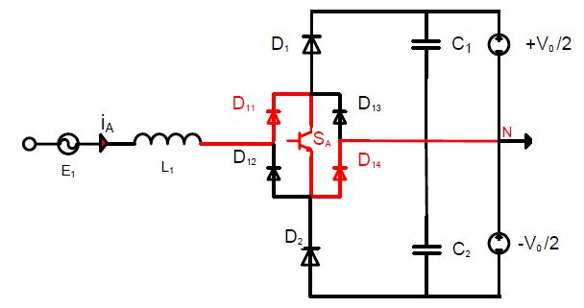
DIFFERENT OPERATING MODES Mode 1:
(a) line current is positive and SA is ON

Slide 8
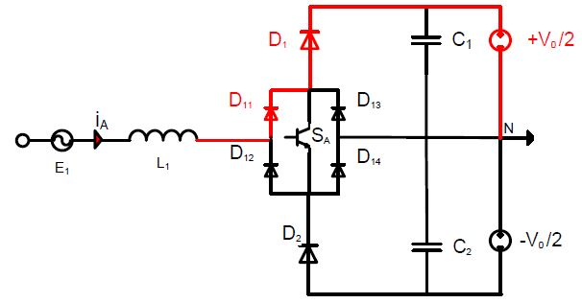
Mode 2:
(b) line current is positive and SA is OFF

Slide 9
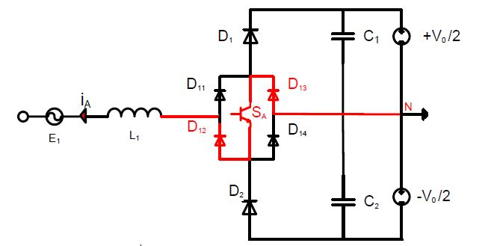
Mode 3:
(c) line current is negative and SA is ON

Slide 10
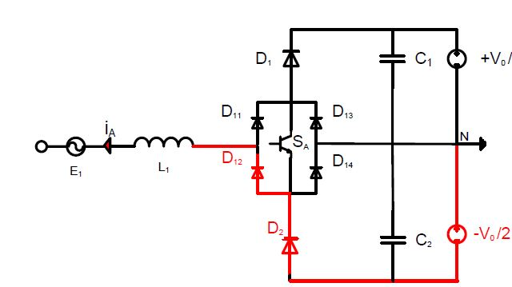
Mode 4:
(d) line current is negative and SA is OFF

Slide 11
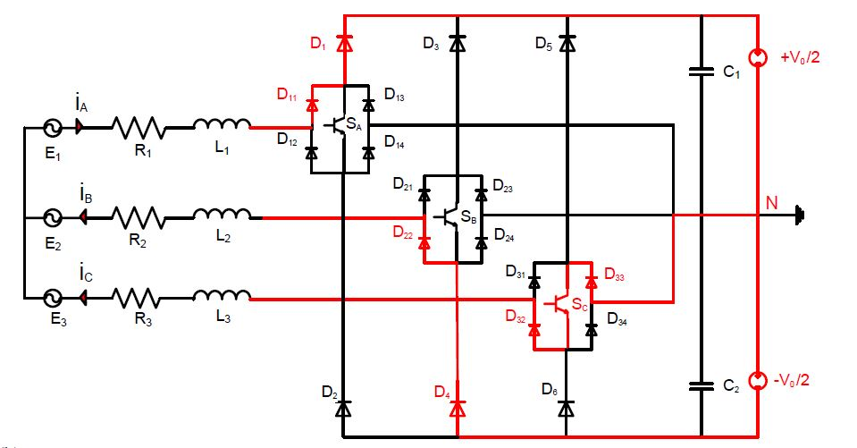
CURRENT PATH FOR SWITCHING POSITION 001

Slide 12
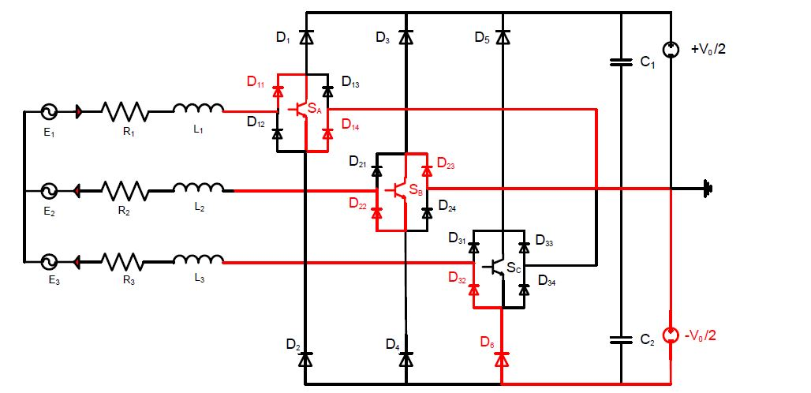
CURRENT PATH FOR SWITCHING POSITION 110

Slide 13
SWITCHING TABLE
If it assumed that the current for phase A is positive and it is negative for both phase B and C. Then eight different switching positions can be considered
S_{A} | S_{B} | SC | VAN | V_{BN} | VCN
0 | 0 | 0 | +V₀/2 | -V₀/2 | -V₀/2
0 | 0 | 1 | +V₀/2 | -V₀/2 | 0
0 | 1 | 0 | +V₀/2 | 0 | -V₀/2
0 | 1 | 1 | +V₀/2 | 0 | 0
1 | 0 | 0 | 0 | -V₀/2 | -V₀/2
1 | 0 | 1 | 0 | -V₀/2 | 0
1 | 1 | 0 | 0 | 0 | -V₀/2
1 | 1 | 1 | 0 | 0 | 0

Slide 14
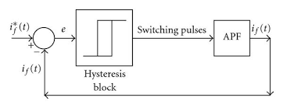
Hysteresis Current Controller
Hysteresis current control is a closed loop circuit which consists of:
1. Comparator
2. Hysteresis relay
3. Active filter

Slide 15
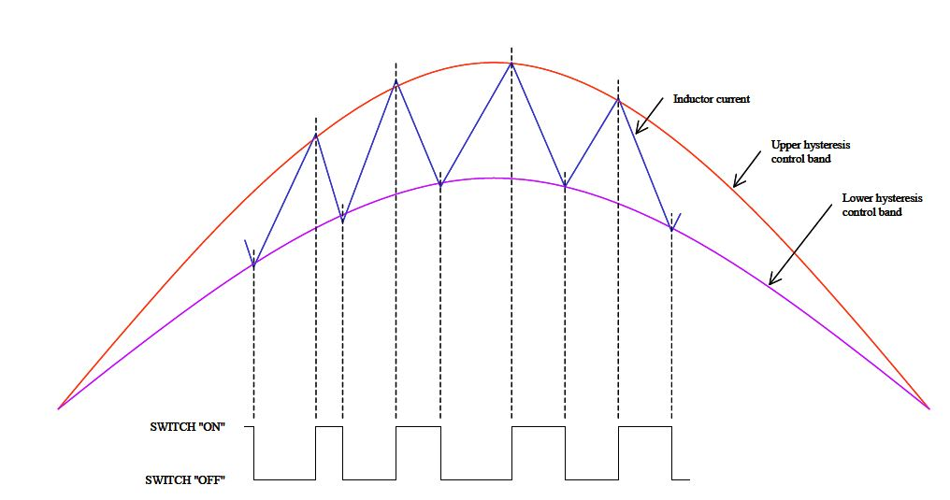
Hysteresis current controlling technique:

Slide 16
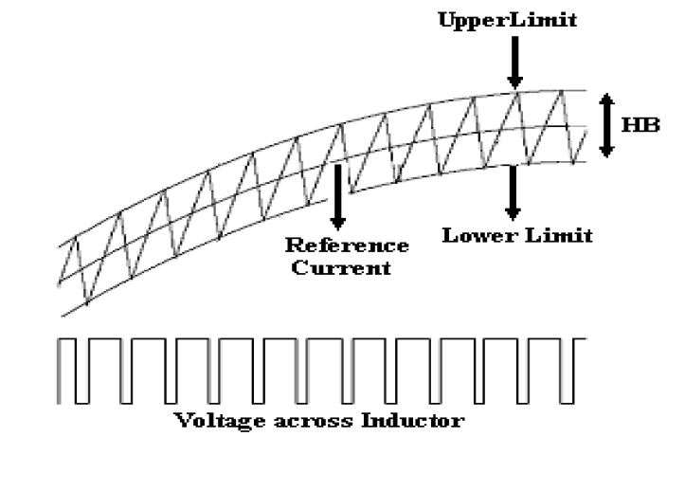
In this method the THD value of voltage and current is 0.3% and 0.45%, which is well below the permissible value of disturbance.

Slide 17
Hysteresis current controller
Two current bands, a lower and an upper band, are set-up.
The current is controlled by means of on-off switching of the switch, to be within the boundaries set-up by the control bands.
The range of the switching frequency can be controlled by increasing/decreasing the current control bands.

Slide 18
Input power factor correction:
Power factor correction shapes the input current of the power supplies to maximize the real power available from the mains. Ideally, the electrical appliances should present a load that matches a pure resistor, in which case the reactive power drawn by the device is zero. Input current must be without harmonics and it should be a perfect replica of the input voltage (pure sine wave) and is exactly in phase with it.
Conventional ac-dc converters suffers from two main problems 1.low input factor and 2.high total harmonic distortion.
Power factor is normally defined as ratio of real power to the apparent power or the cosine of the phase angle between voltage and current waveforms. This definition of power factor is valid only when both the voltage and current are pure sine wave and the power factor arises due to the displacement in phase angle between voltage and current.

Slide 19
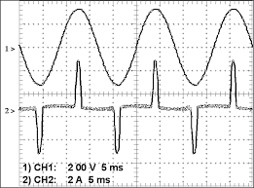
In AC-DC converters the input voltage and current will be:
Here the voltage and current are in phase with each other. But power factor will not be 1.

Slide 20
In non linear loads like AC-DC converters, SMPS and other power electronic converters ,power factor is not only a function of displacement between the current and voltage but also a function of distortion of current form.
Input power factor = displacement factor * distortion factor.
Displacement factor tells us how much utilization of the source is reduced due to phase shift between the voltage and fundamental component of the current.
Distortion factor tells us how much utilization of the source is reduced due to harmonic currents that do not really contribute any power.

Slide 21
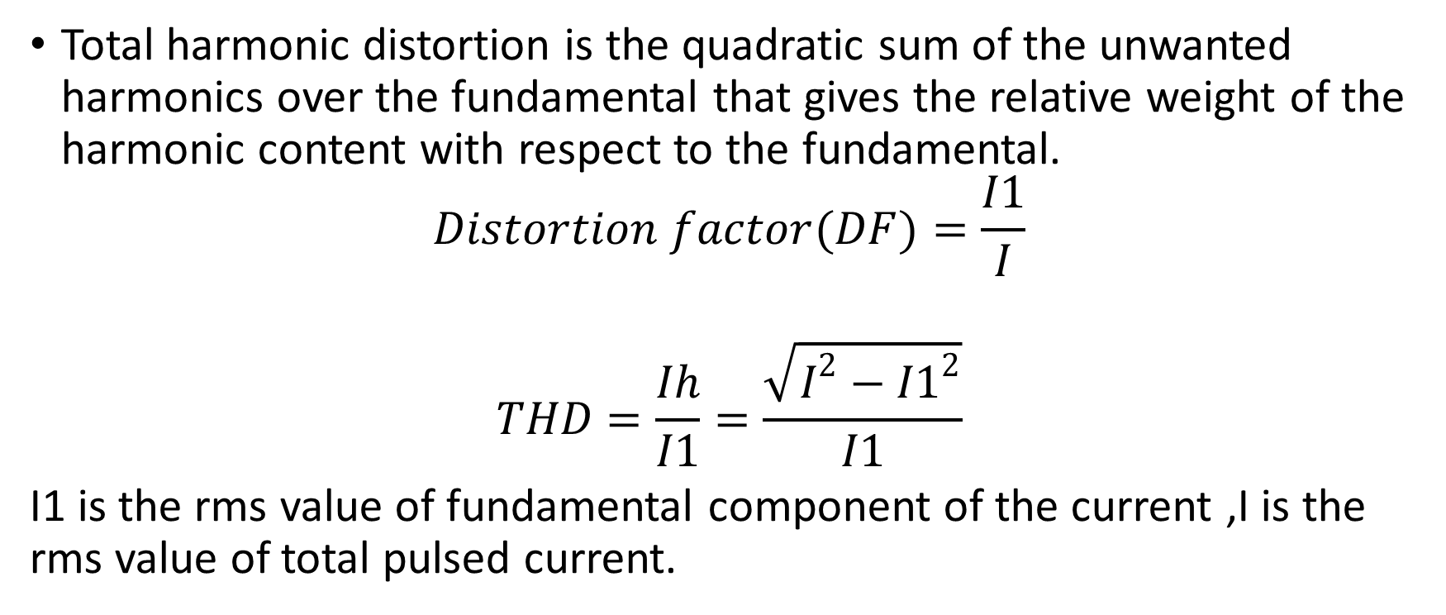
Total harmonic distortion is the quadratic sum of the unwanted harmonics over the fundamental that gives the relative weight of the harmonic content with respect to the fundamental.
$$Distortion factor(DF)=\frac{I1}{I}$$
$$THD=\frac{Ih}{I1}=\frac{\sqrt{I^{2}−{I1}^{2}}}{I1}$$
I1 is the rms value of fundamental component of the current ,I is the rms value of total pulsed current.

Slide 22
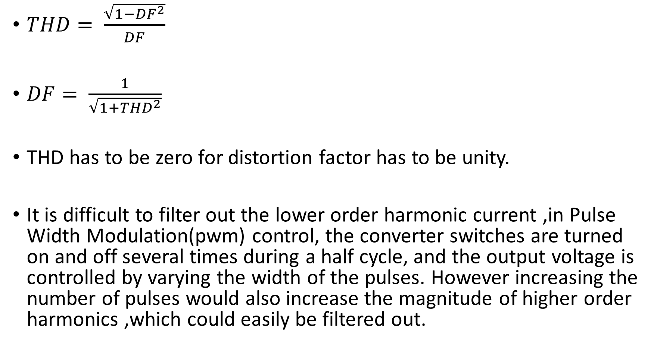
$THD= \frac{\sqrt{1−{DF}^{2}}}{DF}$
$DF= \frac{1}{\sqrt{1+{THD}^{2}}}$
THD has to be zero for distortion factor has to be unity.
It is difficult to filter out the lower order harmonic current ,in Pulse Width Modulation(pwm) control, the converter switches are turned on and off several times during a half cycle, and the output voltage is controlled by varying the width of the pulses. However increasing the number of pulses would also increase the magnitude of higher order harmonics ,which could easily be filtered out.

Slide 23
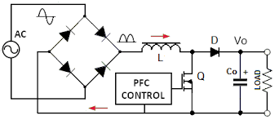
Active shaping of input line current:
By using a power electronic converter for current shaping ,it is possible to shape the input current drawn by the rectifier to be sinusoidal and also in phase with the input voltage.
A step up (boost) dc-dc converter is used as the current shaping circuit.

Slide 24
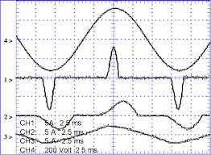
1.Input current without pfc 2.input current with passive pfc 3.input current with active pfc 4.input voltage

Slide 25
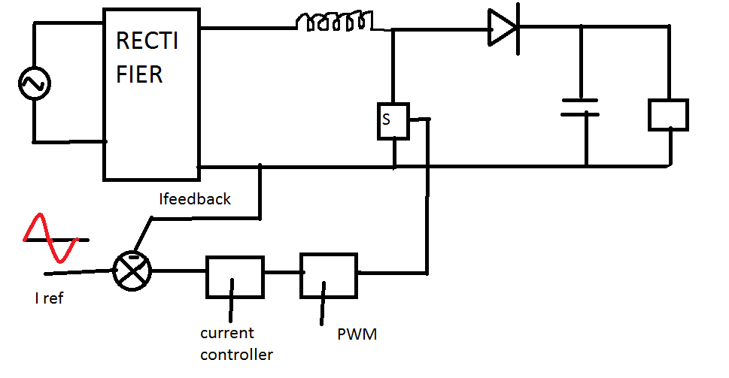
Active power factor correction with boost converter:

Slide 26
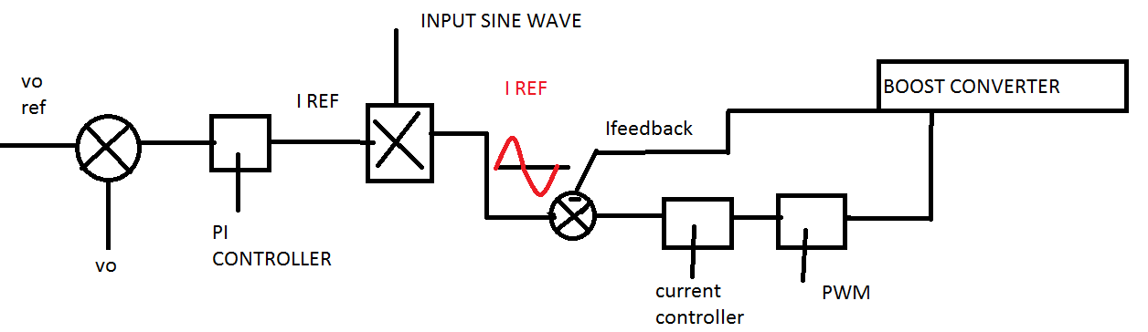
CONTROL LOOP:

Slide 27
With active pfc we get unity power factor.
v
s
i
s
ω
t
(
b)
│
v
s
│
i
L
ω
t
(
c)

Slide 28
Therefore by the combination of rectifier and boost converter ,we get unity power factor by properly switching the boost converter. This concept of active power factor correction is used in Vienna rectifier which is combination of 3phase diode rectifier and boost converter.

Slide 29
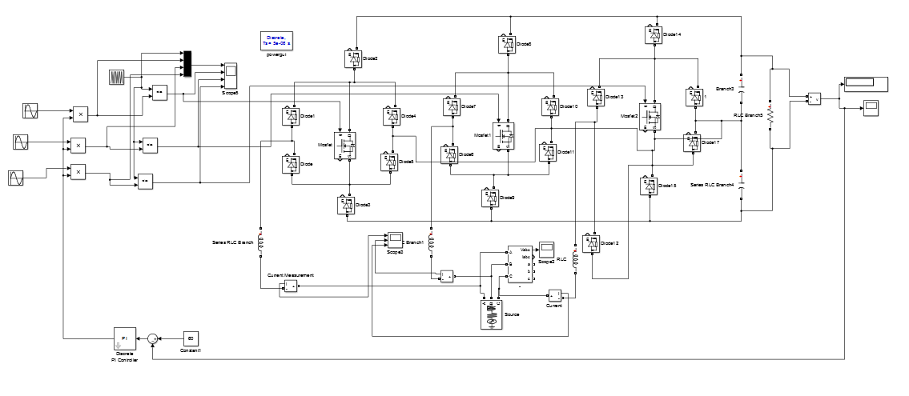
Hardware Simulation:

Slide 30
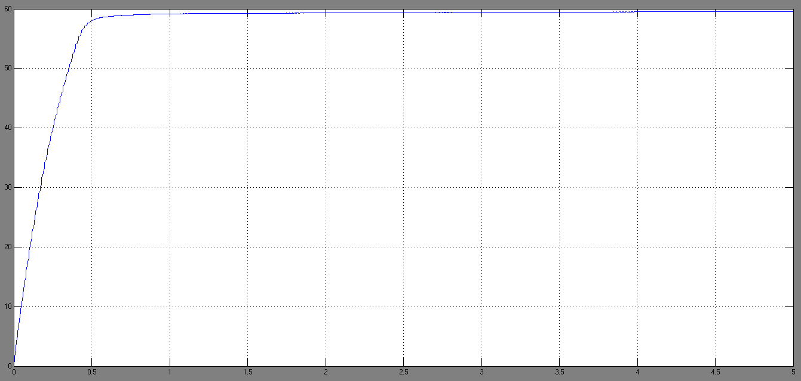
Output voltage:

Slide 31
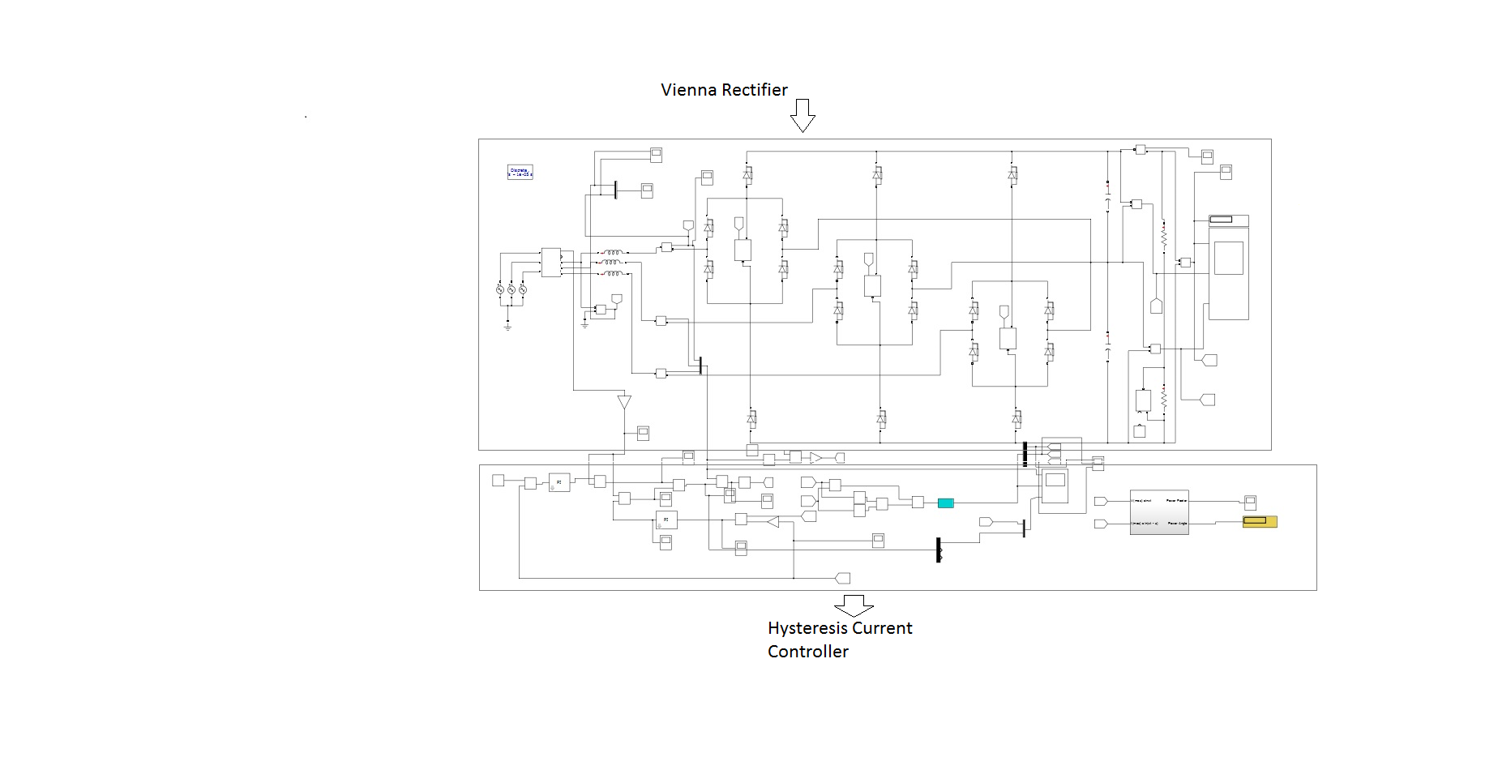
MATLAB Simulation:

Slide 32
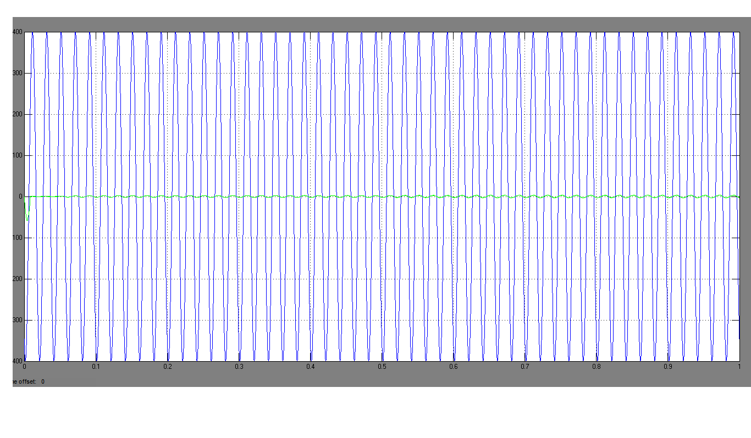
INPUT POWER FACTOR

Slide 33
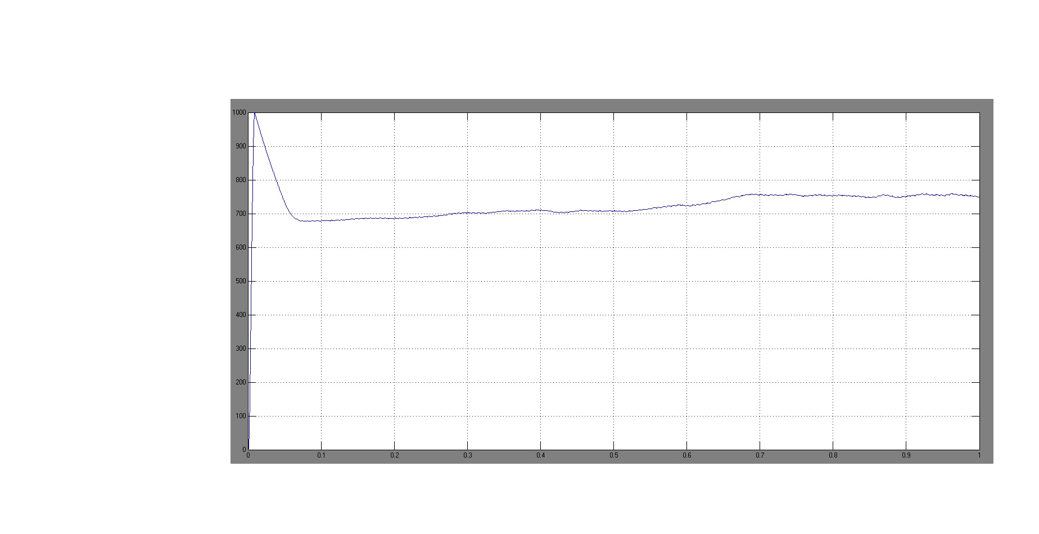
OUTPUT VOLTAGE

Slide 34
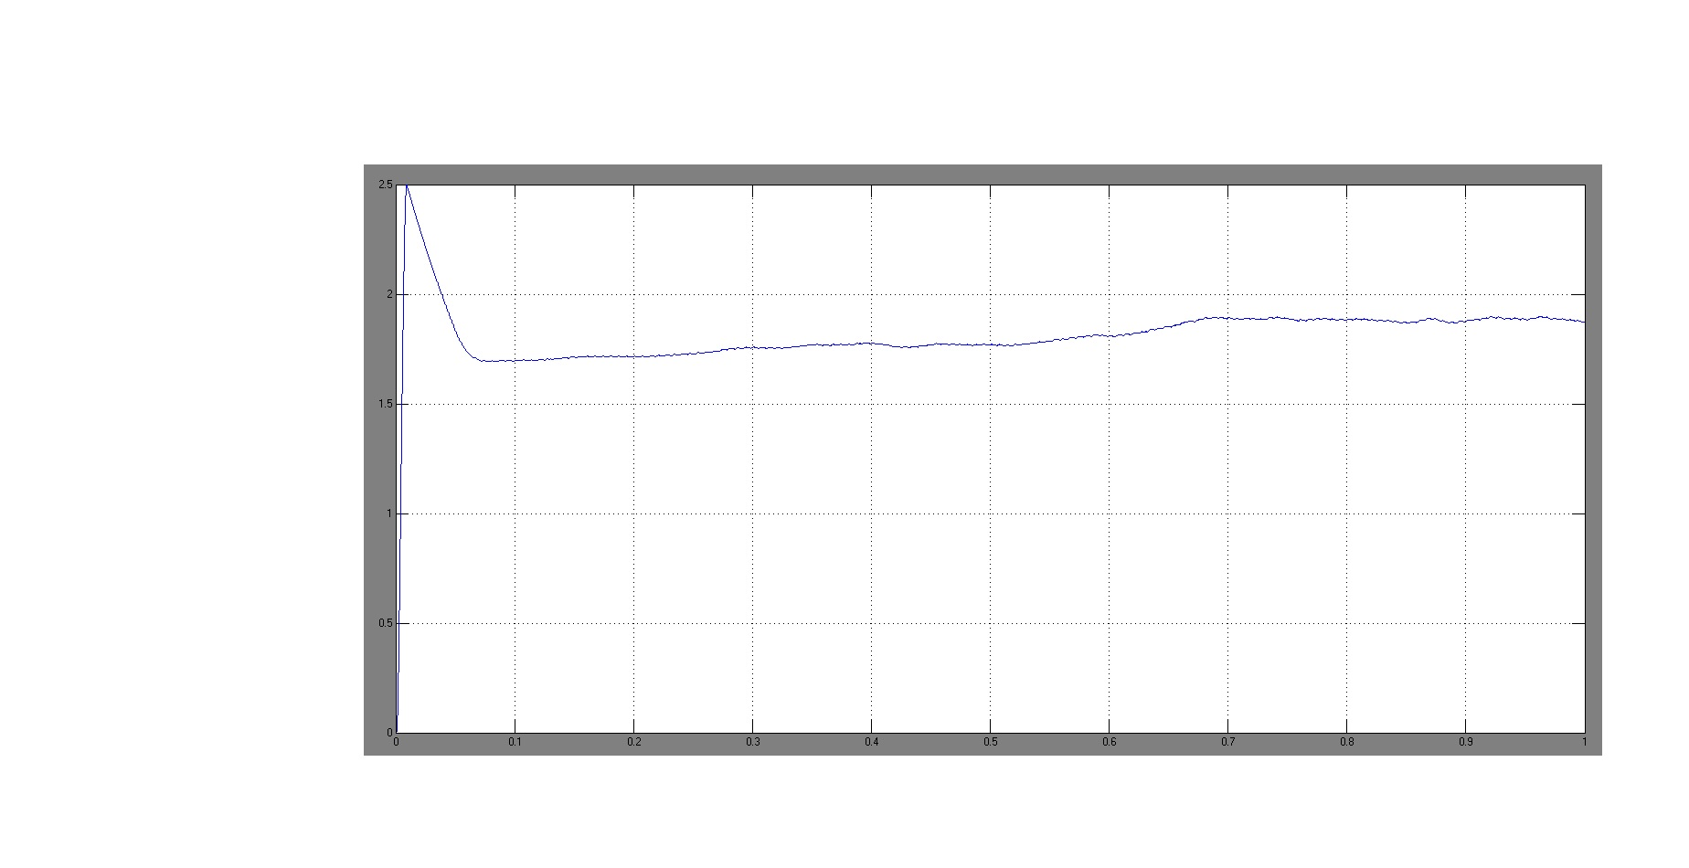
OUTPUT CURRENT

Slide 35
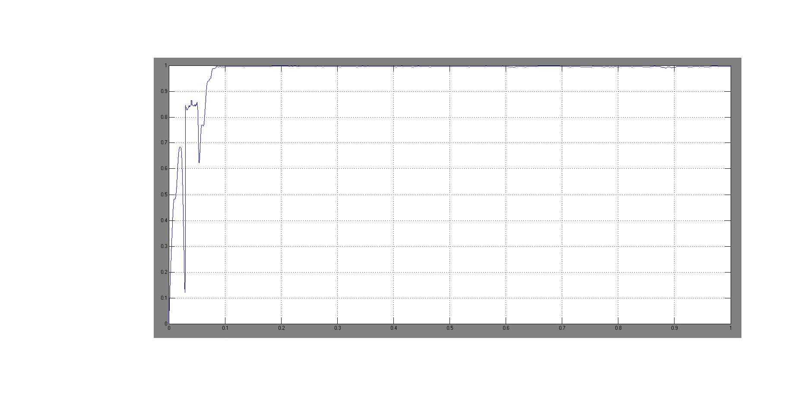
INPUT POWER FACTOR

Slide 36
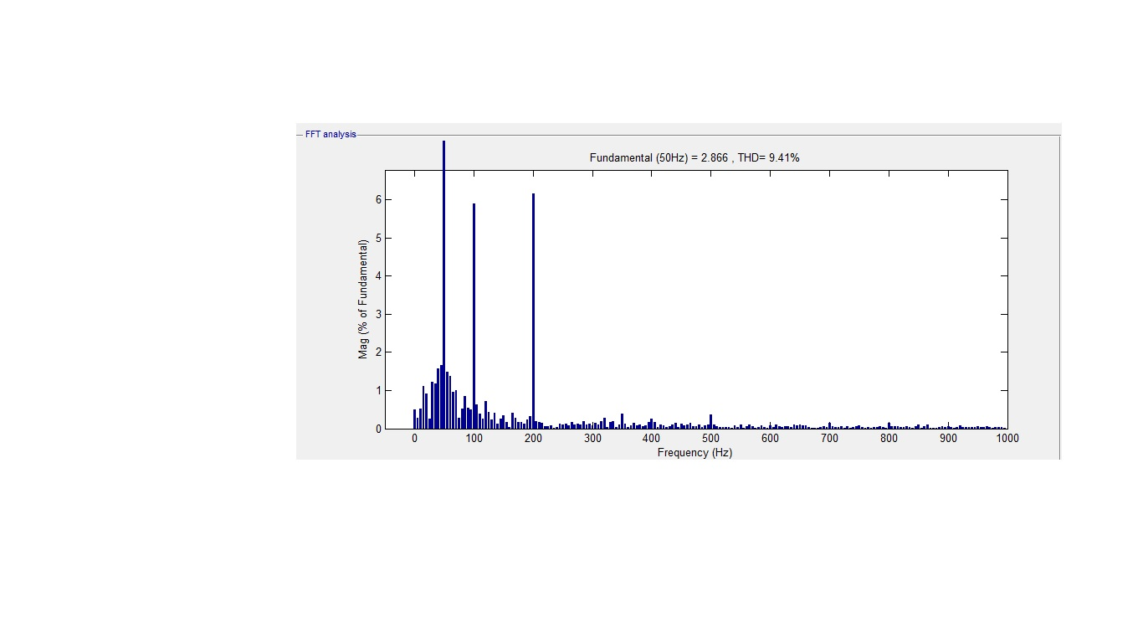
Total Harmonic Distortion

Slide 37
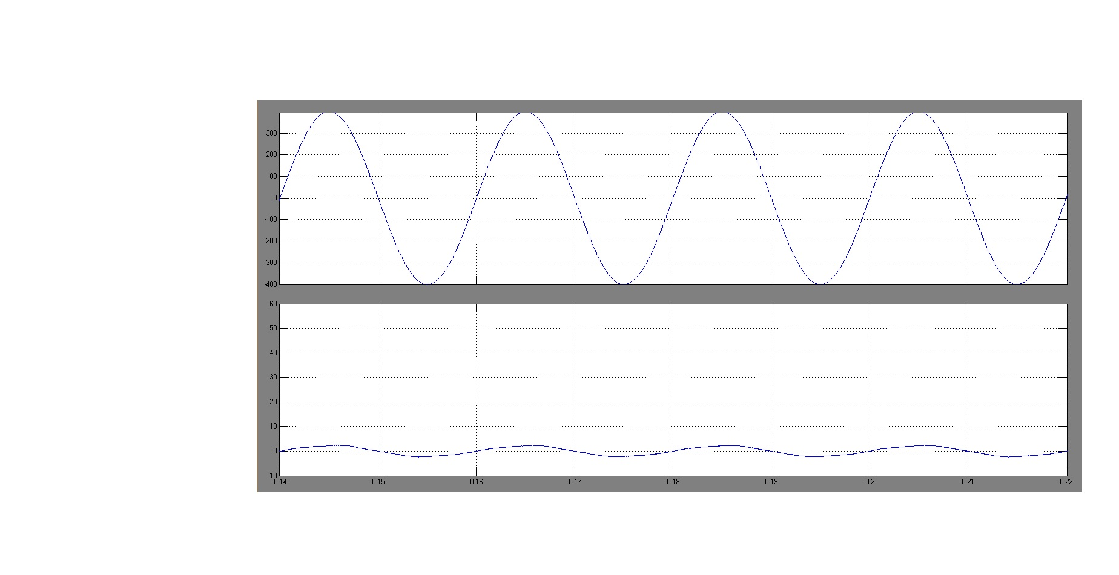
Input voltage and current

Slide 38
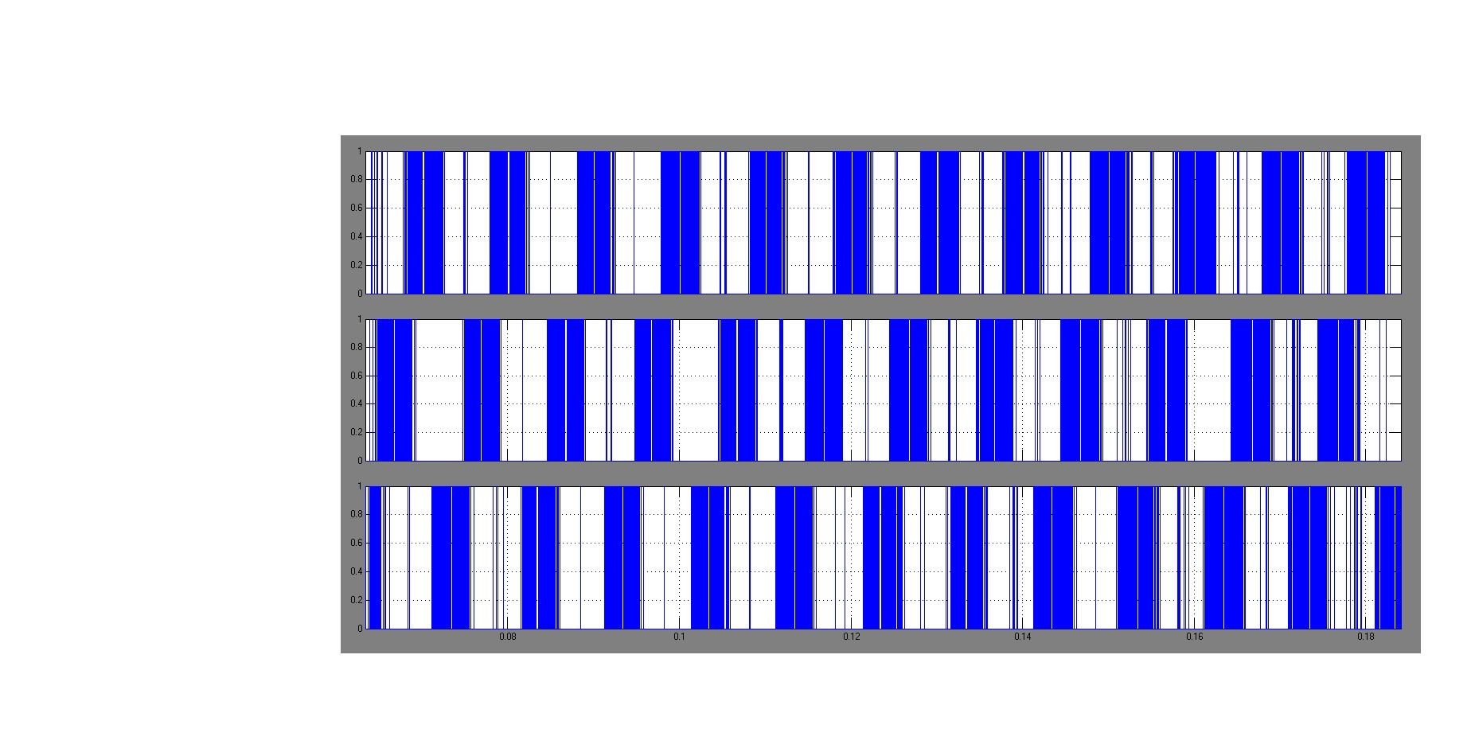
PWM Pulses

Slide 39
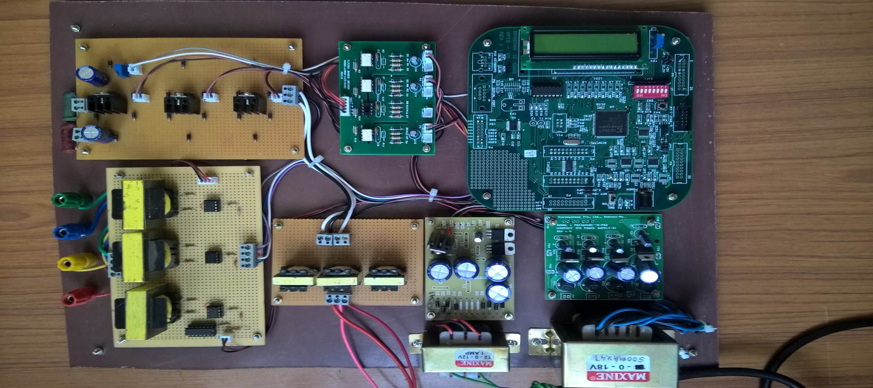
Hardware Model

Slide 40
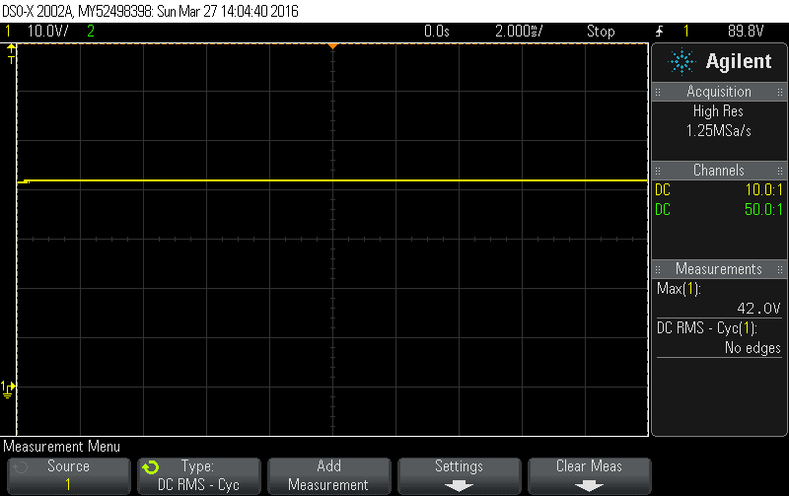
Output voltage:

Slide 41
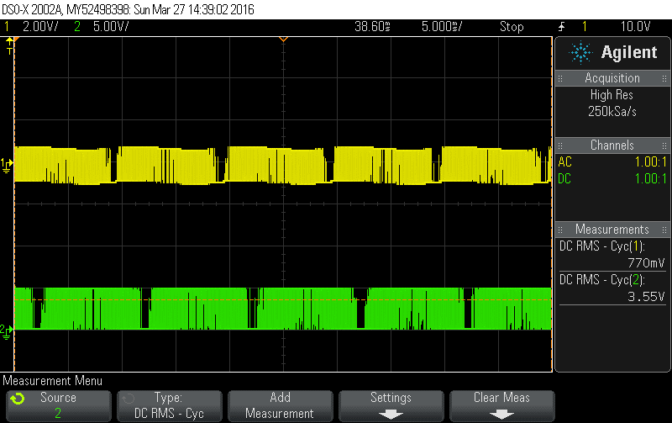
PWM pulse: (Gate 1 and 2)

Slide 42
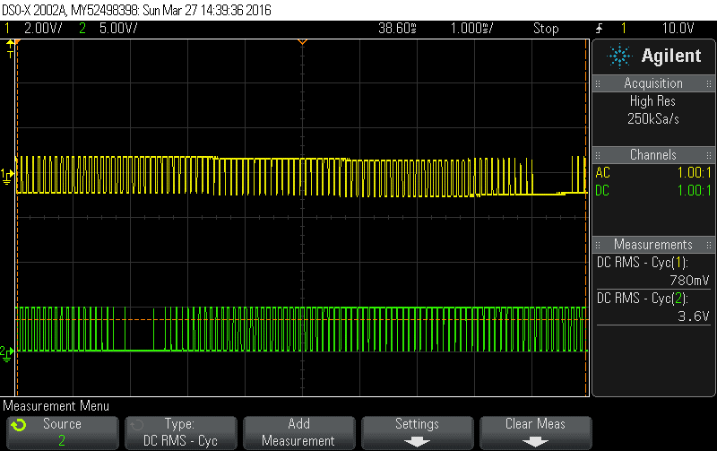

Slide 43
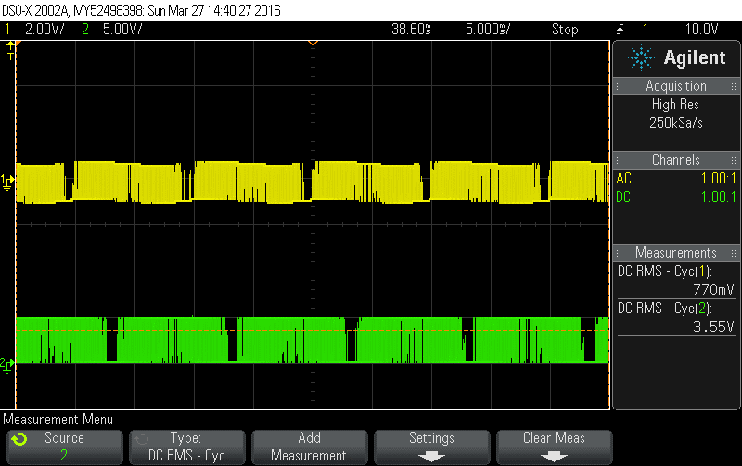
PWM pulse: (Gate 2 and 3)

Slide 44
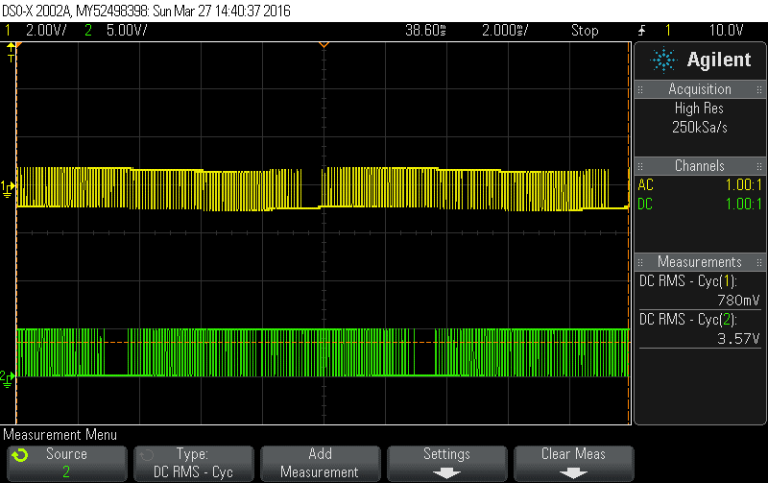

Slide 45
Advantages:
Has continuous sinusoidal input current
No need for a neutral wire
Low number of IGBTs used
Low manufacturing cost
Reduce blocking voltage stress on power semiconductor
Reduction in switching loss of the power semiconductors by almost 40% .

Slide 46
Wide voltage range .
Higher efficiency.
Boosting ability.
Production of three levels of voltage with two equal DC voltages.

Slide 47
References:
Debranjan Mukherjee, Debaprasad Kastha (2014), ‘Voltage sensorless control of the three-level three switch Vienna rectifier with programmable input power factor’, IET Power Electronics, Vol.8, Issue 8, pp.1349-1357.
June-Seok Lee, Kyo-Beum Lee (2015), ‘Performance Analysis of Carrier-Based Discontinuous PWM Method for Vienna Rectifiers with Neutral-Point Voltage Balance’ IEEE Transactions on Power Electronics, Vol.31, pp.4075-4084.
Krishna Kumar M J, Vinod John (2012), ‘Comparison of 3-phase, 3-level UPF Rectifier Circuits for High Power Applications’, IEEE International Conference on Power Electronics, Drives and Energy Systems, pp.1-6.

Slide 48
Nicole C. Foureaux, James H. Oliveira J., Filipe D. de Oliveira and Braz de J. Cardoso Filho Rafael S. de Faria (2013), ‘Command Generation for Wide Range Operation of Hysteresis Controlled Vienna Rectifiers’, IEEE, pp 1379-1384.
Nicole C. Foureaux, James H. Oliveira, Jr., Filipe D. de Oliveira, Braz de J. Cardoso Filho, and Rafael S. de Faria, (2015) ‘Command Generation for Wide-Range Operation of Hysteresis-Controlled Vienna Rectifiers’, IEEE, Vol.51, pp.2373-2380.
Rajesh, M. and Bhim Singh (2012), ‘Power Quality Improvement in Switched Reluctance Motor Drive Using Vienna Rectifier’, IEEE, pp. 1-7.

Slide 49
Reza Ahrabi, R. and Ajami, A. (2015) ‘Controlling of a three phase Vienna Rectifier under Utility Side Distortion Based on Sliding Mode Controller’, The 6th International Power Electronics Drive Systems and Technologies Conference, pp.334-339.
Shlomi Gadelovitz and Alon Kuperman (2012), ‘Modeling and Classical Control of Unidirectional VIENNA Rectifiers’, IEEE, pp.1-4.
Venkata Ranganadh, B., Mallikarjuna Prasad, A. and Madichetty Sreedhar (2013) ‘Modelling And Simulation Of A Hysteresis Band Pulse Width Modulated Current Controller Applied To a Three Phase Voltage Source Rectifier By Using MATLAB’, International Journal of Advanced Research in Electrical, Electronics and Instrumentation Engineering, Vol.2, Issue 9, pp.4378-4387.

